Slide 1
Reliability Engineering and Management in New Product Development Dr. Steven Li Department of IE & EM email: stevenli777@gmail.com
Notes:
Refer Kapur and Liao’s lecture notes for certain parts as well as RAMS reliability engineering tutorial

Slide 2
Topics to be covered
Reliability Management
Reliability in Product Design
Reliability Tools
Boundary Diagram
Functional Block Diagram / FBD
Event Sequence Diagram
Weibull Analysis

Slide 3
New Product Development
Consumer needs changes
Changing technology
Marketing environment changes
Continuous Improvement & New Product Development
High % of total revenue
Not to lose market share
To stay ahead of Competition

Slide 4

New Product Development
Planning
Product/Process design & development
Product/Process V&V
Production
Business case
(new idea)
Prototype/pilot
(Build components/ system)
Concept design
(System requirement identification)
Production phase
Prototype test
(Test components/ System)
Field performance
Detail design
(Component requirement identification)
Verification &Validation
(System and process V&V)

Slide 5





New Product Development
NPD programs are often plagued with:
Cost overruns, Schedule delays, and Quality issues.
Recent news on NPD delays, cost overruns, and quality issues
Product | Company | Issues | Year | Source
787 Dreamliner | Boeing Co | Delay due to a structural flaw | 2009 | The Wall Street Journal
Chevy Volt | General Motors | Cost overrun during design | 2009 | CNN Money
The Honda/GE HF120 turbofan engine | Honda | Design issues: An unanticipated test program glitch. A part of the gearbox failed during the test. Rebuild the engine and begin the test again. | 2013 | Flying
F-35 | United Technologies Corp.’s Pratt and Whitney unit | Delays in delivering engines. Quality flaws and technical issues. Systemic issues and manufacturing quality escapes. | 2014 | Defence-aerospace.com Bloomberg Business
Sikorsky | US Marine Corps' (USMC's) | A failure in the main gear box and need for redesign of the component. Problems with wiring and hydraulics systems. Budget constraints. | 2015 | HIS Jane’s 360

Slide 6


New Product Development
NASA’s main projects that faced cost and time overrun:
The International Space Station.
Prime contract had grown: 25%
(from $783M to $986M, the 3rd increase in 2 years).
The NASA Ares-I launch system.
Cost overrun: 43%
(from $28 billion original estimate to $40 billion)
The Department of Defense (DoD)
The set of 96 major new weapon system development programs (2000-2010) have:
an average development cost growth of 42%,
an average delay of 22 months.
50% of the DOD’s NPD programs faced cost overrun.
80% experienced an increase in unit costs from initial estimates.

Slide 7
Reliability Management - Plan
Develop Reliability Program Plan - identifies specific tasks, with start and completion dates, and explains how these tasks are coordinated and integrated with major program milestones for design, manufacturing, and testing;
Plan need to address
Monitoring/Control of Subcontractors and Suppliers;
Program Review;
Failure Reporting, Analysis, and Corrective Action System (FRACAS);
Failure Review Board;
Reliability Modeling;
Reliability Allocations;
Reliability Predictions;
Part Derating;
Thermal Reliability;
Reliability Development/Growth Testing.

Slide 8
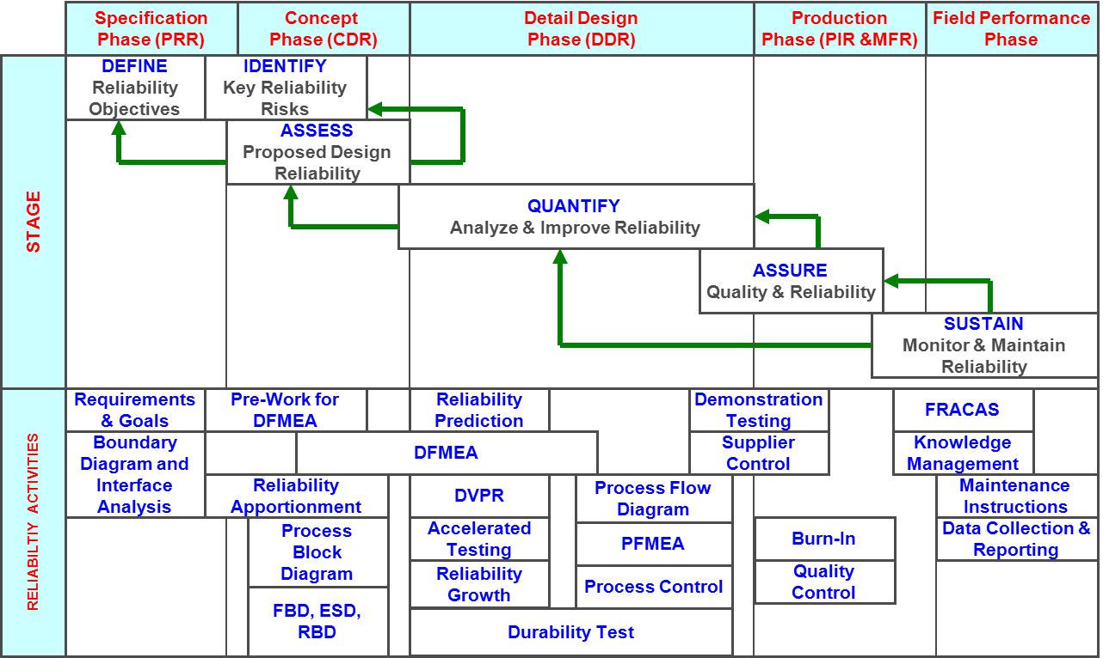
Reliability Management

Slide 9
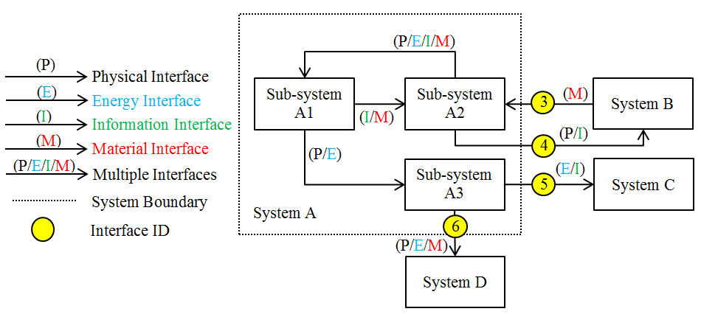
Boundary Diagram

Slide 10
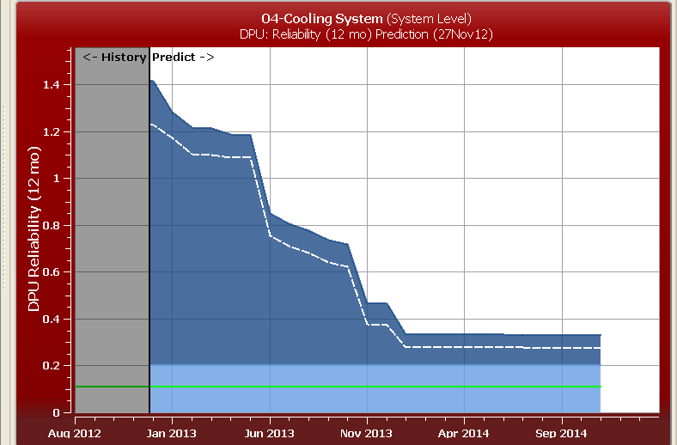
Reliability Management – Monitoring and Prediction

Slide 11
Reliability in Product Design
Design for Reliability
Purpose – system design to achieve specific reliability goals
Reliability specification should include:
• Definition of product failure
• Conditions in which the product will
be stored, transported, operated
and maintained
• Definition of time (calendar, cycle )

Slide 12
Reliability Allocation
Goal – allocate the reliability of components such that:
H(R₁(t), R₂(t) ,…, R_{n}(t)) ≥ R*(t)
where
R*(t) = goal of the system reliability at time t
R_{i}(t) = the reliability allocated to component i
H(.) = the function of a system configuration

Slide 13
Reliability Allocation
Available methods
Minimum cost allocation (similar to
what we have done, however treat
system reliability as a constraint)
Engineering approaches
Aeronautical Radio Inc. (ARINC) method
Advisory Group on Reliability of Electronic Equipment (AGREE) method

Slide 14
Reliability Allocation
ARINC Method – Proportional allocation
Developed in 1951.
Assumption:
System consists of n independent components connected in series
Each component has a constant failure rate λi such that:
λi * = Wi ×λ_{system}
where W_{i} = λ_{i} / Σλ_{i} is the allocation
weight for the i^{th} component.

Slide 15
Reliability Allocation
Example - ARINC Method
• A system has 4 components with the
failure rates:
λ1 = 0.002, λ2 = 0.003,
λ3 = 0.004, λ4 = 0.007.
The requirement is: the system should keeps functioning with the probability of 0.95 during a 5-hour mission.
Allocate the reliability of these components to meet the requirement.

Slide 16
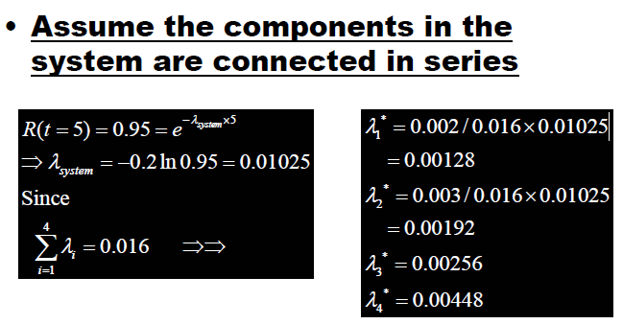
Solution – ARINC Method

Slide 17
AGREE Method
Developed in 1957.
Assumption:
System consists of n independent modules each having ni components
Contribution of the ith module to the system reliability goal is:
Ri * = [Rsystem(t)]^(n_{i}/N)
where N = total number of components
Σni in the system.

Slide 18

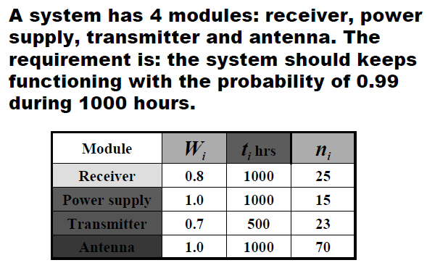
AGREE Method
Assumption (continued):
1- Ri * = 1-[Rsystem(t)]^(ni/N) = Wi ×[1-e(- λiti)]
where Wi = importance index of the ith module (prob. that the system will fail given module i has failed).

Slide 19
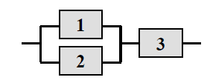
Example - Other Method
A system has the following structure. The goal is: the system reliability is 0.95.
Idea: allocate the reliability of these components
by balancing the reliability of the subsystems.
Benefit: avoid over-improving a subsystem
R₁ = R₂ = 0.8409, R₃ = 0.9747

Slide 20
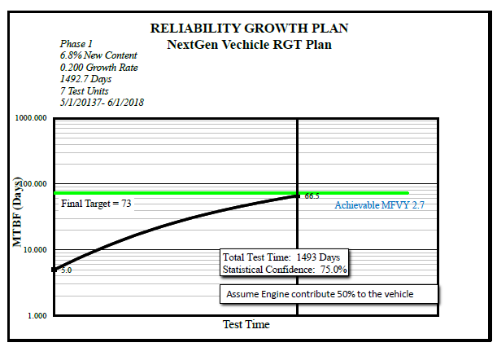
Reliability Prediction – Reliability Growth
MTBF
Total test time
Reliability Growth Test (RGT)
Why Reliability is able to grow?
Find root cause for various failure modes
Analyze and fix the problems by design change
Management involvement
Resource investment, e.g., Testing facility, Service manual,...
……………

Slide 21
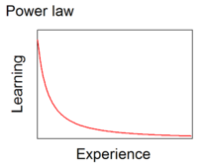
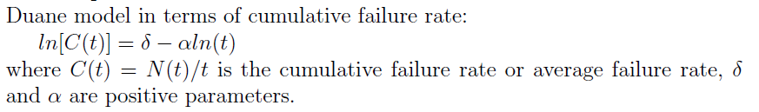


Reliability Prediction – Reliability Growth
How to model the Reliability Growth?
Duane model - 1962
The cumulative MTBF and the cumulative testing time is linear on a log-log scale – An empirical model
Crow AMSAA - 1972
Statistically model the growth process as a non-homogeneous process NHPP – A more generic and statistics-based model
- Maximum likelihood estimator (MLE)
- Goodness-of-fit is discussed

Slide 22
Reliability Prediction – Reliability Growth
After cumulating some testing time, the reliability growth should look like this
Planned growth
Actual growth

Slide 23
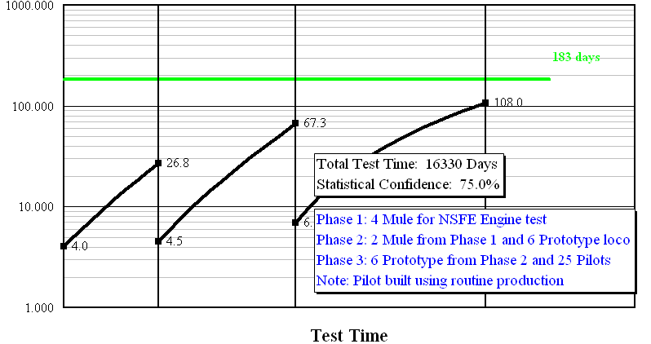
Reliability Prediction – Reliability Growth
One more example for a multi-stage reliability growth planning
Determine the test quantity in each of the product development stages

Slide 24
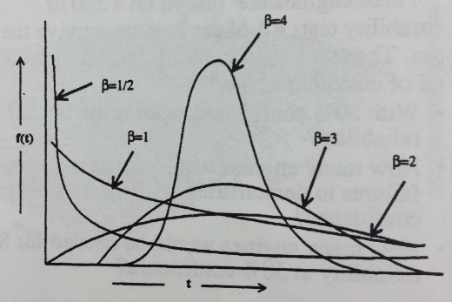
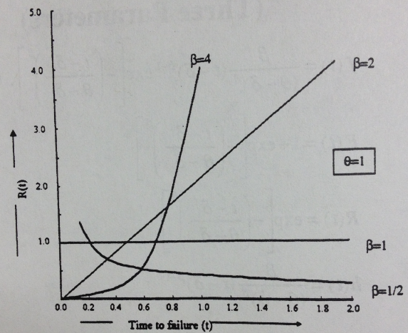
Weibull Life Model
Different Weibull shapes (pdf)
Different hazard functions

Slide 25
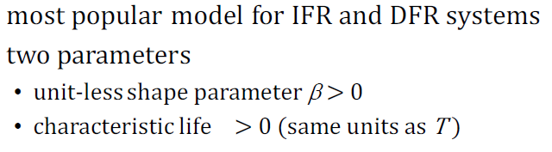
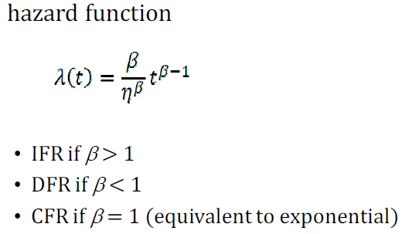
Weibull Life Model

Slide 26
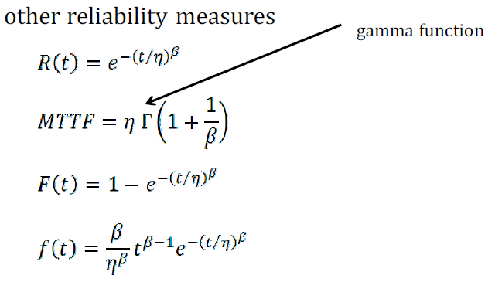
Weibull Life Model

Slide 27
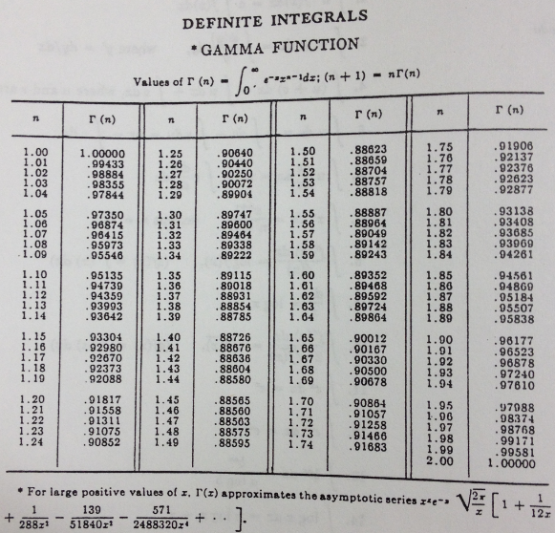

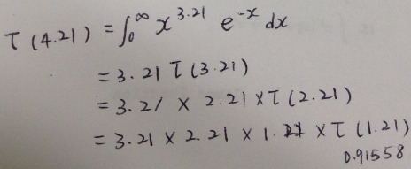
Gamma Function
Γ
Exercise:

Slide 28
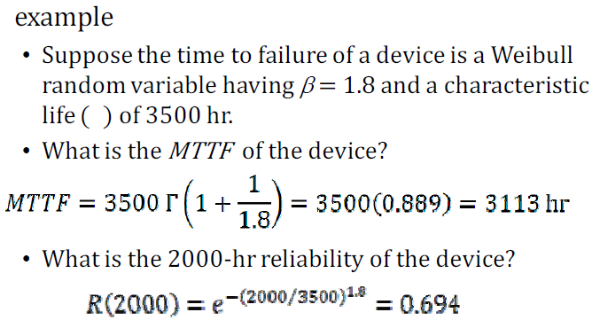
Weibull Life Model

Slide 29
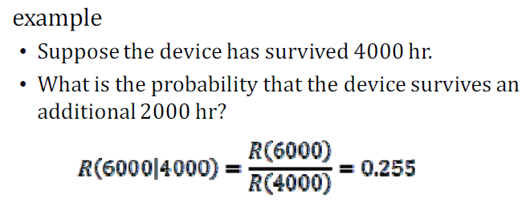
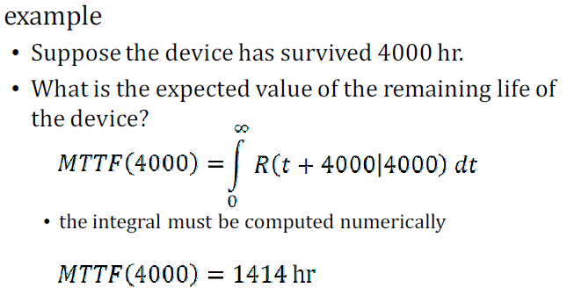

Weibull Life Model

Slide 30
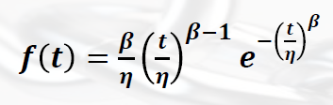


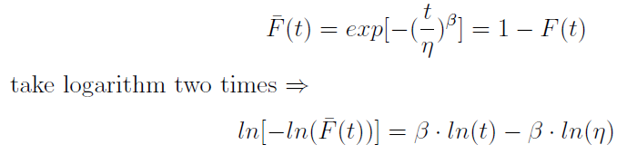
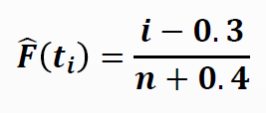
Weibull parameter estimation
Notes:
Show least square example
May also show the MLE results refer to the text book

Slide 31
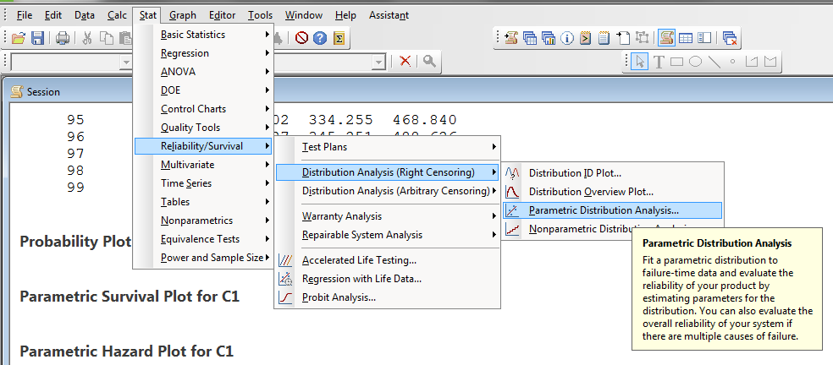
Weibull parameter estimation
In Minitab

